Slide 1


BE Project Presentation On “Stock Recommendations And Price Prediction ”
Smt. Kashibai Navale College of Engineering,Pune
Presented by
Harish Hatmode 18U424 Guided
Pragati Bankar 18U417 By
Vishal Wankhede 18U420 Dr. K. N. Honwadkar
Onkar Kulkarni 18U426

Slide 2
Outline
Problem Statement
Introduction
Motivation
Literature Survey
Gap Analysis
Objectives
Social Impact
Conclusion
References

Slide 3
Problem Statement
Stock Recommendations And Price Prediction By Exploiting Business Commodity Information Using Data Mining And Prescriptive Analytics Techniques

Slide 4
Introduction
Commodity price forecasting is a popular and important topic in financial and academic Studies.
Business Intelligence is very effective to implement forecasting commodity prices and stock modeling.
Many methods like technical analysis, fundamental analysis, etc. are used to predict the price in the market but none of these methods acceptable consistent for prediction.

Slide 5
In this project we attempt to implement an Business Intelligence technique to predict commodity market prices and stock modelling.
We select a certain group of raw material and parameter’s with relatively significant impact on the price of a commodity.

Slide 6
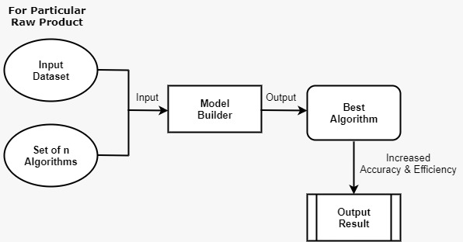
Our Approach

Slide 7
Motivation
Stock recommendation and prediction is a very tricky business, and forecasting commodity is dependant on historic price data.
Fluctuations in commodity prices affect the global economic activity.
commodity price movements have a major impact on overall performance therefore commodity-price forecasts are key input to policy planning and formulation.

Slide 8
Spot prices and future prices are non-stationary they form a co-integrating relation. Spot prices tend to move towards future prices.
For efficient manufacturing the actual real-time consumption is necessary but, it is not always possible to analyse real-time data.
Effects of market Inflation.

Slide 9
Literature Survey
Author | Paper Name | Publication House & Year | Description
1.Zang Yeze. 2.Wang Yiying | Stock Price Prediction Based on Information Entropy and Artificial Neural Network | IEEE 2019 | This paper propose a combined machine learning framework with information theory and Artificial Neural Network (ANN).
1.Ishita Parmer. 2.Navanshu Agarwal | Stock Market Prediction Using Machine Learning | IEEE 2018 | The paper focuses on the use of Regression and LSTM based Machine learning to predict stock values.

Slide 10
Author | Paper Name | Publication House & Year | Description
1.Sunitha Cheriyan 2.Shaniba Ibrahim. 3.Saju Mohanan. 4.Susan Treesa | Intelligent Sales Prediction Using Machine Learning Techniques | IEEE 2018 | The main purpose of this research is to evaluate and analyze the use of data mining techniques for sales forecasting, to produce models which are comprehensive and reliable.
1.M.I. Yasef Kaya 2.M. Elif Karshgil. | Stock Price Prediction Using Financial News Articles | IEEE 2010 | Novel approach was used to analyze textual statements in news articles

Slide 11
Gap Analysis
Paper Name | Method Used | Accuracy/Result | Issues
Stock Price Prediction Based on Information Entropy and Artificial Neural Network | Time series analysis method based on information theory and LSTM | Good | Used for limited data set.
Stock Market Prediction Using Machine Learning | Compared two models: LSTM and Linear Regression Model | LSTM is more accurate then LRM | Error handling rate of LRM is less. Dataset used was limited.

Slide 12
Paper Name | Method Used | Accuracy/Result | Issues
Intelligent Sales Prediction Using Machine Learning Techniques | Compared Three Models: Generalized Linear Model (GLM), Decision Tree (DT) and Gradient Boost Tree (GBT) | Gradient Boost Tree is more better then two models | Required huge amount of time to execute. Also fields and attributes, used in this analysis were insufficient
Stock Price Prediction Using Financial News Articles | Word couple features approach | Accuracy rate of this approach is Low | Get Affected By insufficient fields and attributes for analysis. Cannot handle Large dataset

Slide 13
Objectives
Performance Evaluation
To achieve best possible revenue by Data Mining
Accuracy and Reliability
To Achieve Effectiveness

Slide 14
Social Impact
It helps to determine production volumes considering availability of facilities, like equipment, capital, manpower, space etc.
It helps in guiding marketing, production and other business activities for achieving these targets.
It helps in taking decision about the plant expansion and change in production .
It helps in preparing production and purchasing schedules.

Slide 15
Conclusion
The progress that this system will bring to the market will be recommendatory and will bring us to a position where we can invest smartly , knowingly and have maximum outcome .
Proper sale forecasting enables better planning and utilization of resources for business to be competitive.
Forecasting is an integral part of sale management since it provides an estimate of the future demand and the basis for planning and making business decisions.

Slide 16
References
M.A. Mittermayer, "Forecasting intraday stock price trends with text mining techniques," In Proceedings of the 37th Annual Hawaii International Conference on System Sciences (HICSS), Big Island/Hawaii, January 2004.
B. Wuthrich, V. Cho, S. Leung, D. Permunetillek, J. Zhang and W. Lam, "Daily stock market forecast from textual web data," IEEE International Conference on Systems, Man, and Cybernetics, San Diego/CA, 11-14 Oct 1998.
G. Gidofalvi, "Using news articles to predict stock price movements," Department of Computer Science and Engineering, University of California, San Diego, 2001.
Zhang Gui-xi and Ma Li-ping, "An Introduction to Forecast and Decision," Beijing: Capital, Economic and Trade University Press, 2006
Z. Wang, A. Tan, F. Li and S.-B. Ho, "Comparisons of learning-based methods for stock market prediction", The 4th International Conference on Cloud Computing and Security (ICCCS 2018), 2018.

